Slide 1
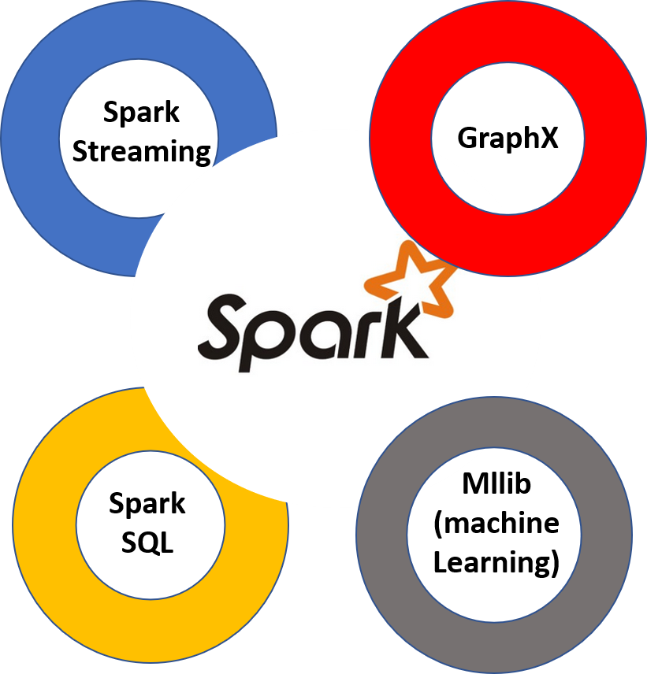
Research Proposal on “EFFECTIVE CLASSIFICATION BASED FEATURE EXTRACTION MODULE FOR BIG DATA USING SPARK MLIB”
Presented By
Mr. Abhimanyu Dutonde
Research Scholar

Slide 2
Outline
Introduction
Literature Survey
Research Gap
Problem Definition
Research Methodology
Conclusion
References

Slide 3
Introduction
High-dimensional data analysis is a challenge for researchers and engineers in the fields of machine learning and data mining.
Feature selection provides an effective way to solve this problem by removing irrelevant and redundant data, which can reduce computation time, improve learning accuracy, and facilitate a better understanding for the learning model or data
we combine multi-strategy feature selection and grouped feature extraction and propose a novel fast hybrid dimension reduction method, incorporating their advantages of removing irrelevant and redundant information
Principal Component Analysis (PCA) based feature extraction is carried out to remove redundant information.
The runtime results of different methods show that the proposed hybrid method is consistently much faster and show better feature extraction results

Slide 4
Literature Survey
Sr. No. | Title of the Paper | Authors | Name of Journal /Year/ISSN No./Volume Number | Proposed Concept and Details
1. | Feature selection based on Fisher score | Malina, | IEEE Transactions 1981 | feature select base methods which can effectively remove the irrelevant features
2 | A Fast Clustering Based Feature Subset Selection Using Affinity Propagation Algorithm | Mr. M. Senthil Kumar, Ms. V. Latha Jothi M.E | International Journal of Innovative Research in Computer and Communication Engineering 2014 | Traditional approaches for clustering data are based on metric similarities
3 | Feature Subset Selection Algorithm over Multiple Dataset | Priyanka M G | Proceedings of IRF International Conference 2014 | fast clustering based feature subset selection algorithm
4 | Unsupervised feature selection based on the Morisita estimator of intrinsic dimension | Golay & Kanevski | Knowledge-Based Systems 2017 | dimensionality reduction filter out some noise and redundant information by reducing the original high-dimensional space to the low-dimensional intrinsic space

Slide 5
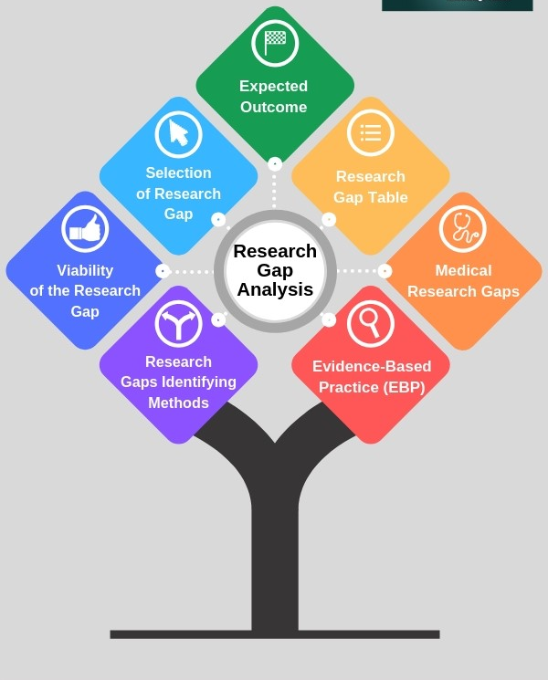
Research Gap Identification
Classification is done on small size of dataset in most of earlier research work so that accurate detection and classification cannot be achieved
Previous work carried out only on leaf images of cotton plant. But disease can affect at any stage of cotton such as seedling, cotton balls, mature cotton leaves.
Disease detection and classification is performed on multiple diseases of multiple plants. But Identification of all the type of diseases of single crop is not achieved.

Slide 6
Research Gap Identification
Less work is done using hybrid of two or more algorithms. So future work can be carried out using hybrid of two or more algorithms.
Accuracy can be improved by using other local features together with global feature.
SVM is use as classifier for accurate classification in many research work.
In earlier research focus on increasing the recognition rate and classification accuracy

Slide 7

Research Objective
One objective for both feature subset selection and feature extraction methods is to avoid overfitting the data in order to make further analysis possible. The simplest is feature selection, in which the number of gene probes in an experiment is reduced by selecting only the most significant according to some criterion such as high levels of activity.
Second Objective is improving the classification accuracy by removing both irrelevant and redundant information of the data.
Third objective is to demonstrate that standard FS methods can be designed in these Big Data platforms and still can prove to be useful when dealing with big datasets, boosting both performance and accuracy.

Slide 8
Proposed Methodology
The spark.ml package aims to provide a uniform set of high-level APIs built on top of Data Frames that help users create and tune practical machine learning pipelines
FS methods can be broadly categorized as:
Wrapper methods, which use an evaluation function dependent on a learning algorithm. They are aimed at optimizing a predictor as part of the learning process.
Filtering methods, which use other selection techniques as separability measures or statistical dependences. They only consider the general characteristics of the dataset, being independent of any predictor.
Embedded methods, which use a search procedure which is implicit in the classifier/regressor.

Slide 9

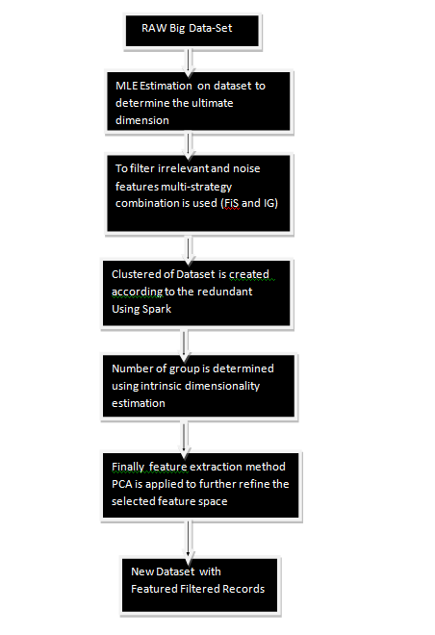
Proposed Methodology

Slide 10
Conclusion
We aim to provide feature selection solution for Big RAW Data-set using combine multi-strategy feature selection and grouped feature extraction .
The proposed method incorporates the advantages of removing both irrelevant and redundant information of the data
By using Spark we aim to provide fast clustering so that the time require to cluster RAWS dataset will be reduce.

Slide 11
References

Slide 12
Thank you
Questions?

